Slide 1

BOPS
Anqi Pan, Cynthia Poon, Mithun Mitra Nomula, Pranita Patra,Yun-Hui Liu

Slide 2
Agenda
Case introduction and data overview
Sales Model
Monthly $Sales--->OLS linear regression
Test Endogeneity/Heteroscedasticity
Interpretation
Return Model--->Logit/Probit
Comparison
Test Endogeneity/Heteroscedasticity
Interpretation
Recommendation and limitation.

Slide 3
Project Overview
1,671,502 observations, 23 variables
- The transaction data cover all transactions made between August 1st, 2010 and July 31st, 2013.
There are three online channels: Store number 2, 6, and 5998.
- Online channels 2 and 6 started the BOPS strategy on August 1st, 2011.
- Online channel 5998 started the BOPS strategy on September 27th, 2012.

Slide 4
Description of Variables
 | Sales | Variable Type
11 | BOPS | Binary
12 | Store Number | Factor
13 | Net Purchase Amount | Continuous
14 | Purchase Date | Time
15 | Year | Factor
16 | Month | Factor
17 | Time Index | Continuous
18 | Rerun Date | Time
19 | Return Store | Factor
20 | Time to return | Continuous
21 | SKU | /
22 | Transaction ID | /
23 | Summary (Categories) | Factor
 | Dependent Variable | Variable Type
1 | Monthly $Sales (generated) | Continuous
2 | Return Probability | Binary
 | Demographic | Variable Type
3 | Income | Continuous
4 | Gender | Binary
5 | Age | Continuous
6 | Child | Binary
7 | Homeowner | Factor
8 | Ethnic | Factor
9 | Length of Residence | Continuous
10 | Customer ID | /

Slide 5
Goals
To evaluate the impact of BOPS policy on monthly $sales and return probability
Dependent Variable:
Monthly $Sales (by category
Return Probability
Key Independent Variable: BOPS

Slide 6
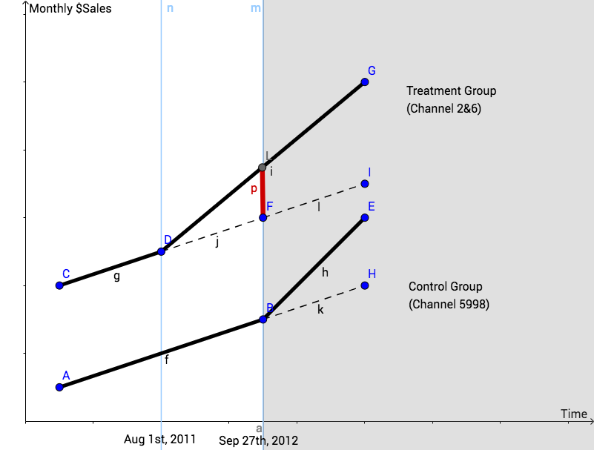
Sales: Graph of theoretical modeling
Difference in difference model
- Online channels 2 and 6 started the BOPS strategy on August 1st, 2011.
- Online channel 5998 started the BOPS strategy on September 27th, 2012.
Assumption 1:
BOPS positively impacts sales.
Actual growth due to BOPS

Slide 7
Sales: Description of New Variables
 | Dependent Variable | Variable Type | Note
1 | Monthly $Sales (by category) | Continuous | generated
 | Sales | Variable Type | Note
1 | BOPS | Binary
2 | Store Number | Factor | 2, 6 and 5998
3 | Summary (Categories) | Factor | 21 categories 1-Bridal, 2- Gold Wed Bands, 20- Diamond Wedding Band
4 | Month_Index | Continuous
5 | Year | Factor
6 | Month | Factor
7 | Treatment (generated) | Binary | Channel 2&6=1,Channel 5998=0
8 | Bridal (generated) | Binary | Category 1/2/20=1
Assumption 2:
BOPS has less impact on Bridal than any other product category.
Notes:
- Product categories:
1-Bridal
3-Solitaires
4-Diamond Fashion
11-Diamond Solitaires Jewelry
20- Diamond Wedding Band
2- Gold Wed Bands
5-Semi Precious
6-Mens
7-Gold Earrings
8-In House Special Event
9-Beads
10-Piercings / Close Out
12-Gold Chain / Jewelry
13-Watches
14-Pre-Owned
15-Specialized Jewelry
16-Estate
17-Events
18-Trade Ins
19-Repair / Warranty
21-Sterling Silver

Slide 8
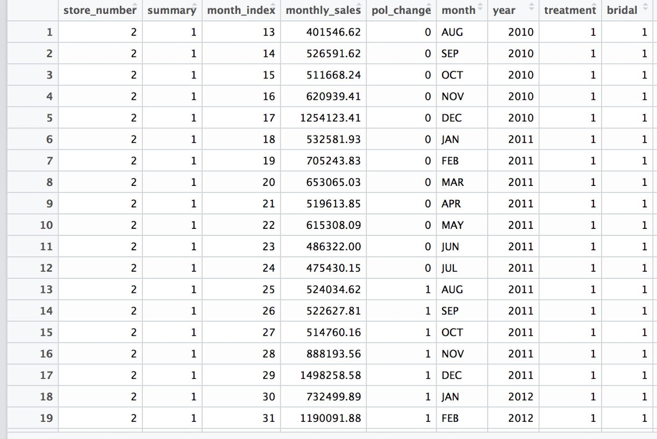
Sales: Overview of the new data set
1,078 observations
9 variables
Key dependent variable:
Monthly $Sales
Key independent variable:
BOPS policy change

Slide 9
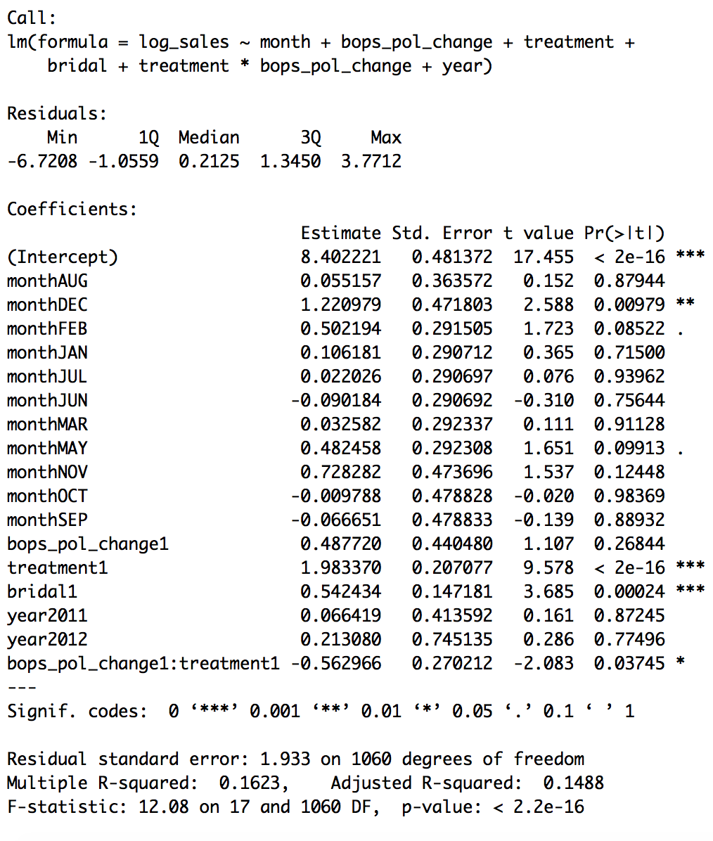
Sales: Final Model
Significant interaction
between BOPS and treatment
Notes:
Model 1: It has interaction between two key independent variables, we are finding out the reaction of sales with respect to policy change and store(treatment) and this is significant but with negative coefficient which is inline with our theory.
BOPS reduces the online sales. BOPS ensures a reliable inventory sharing system, so customers tend to research online and then buy in nearby stores. BOPS reduces the online purchase and increase in-store purchase and traffic.
Model 2: It has interaction between three independent variables, we found an observation of how sales are reacting respect to policy change, store (treatment) and this is insignificant so we can say that bridal category products are not impacted with policy change and store.

Slide 10
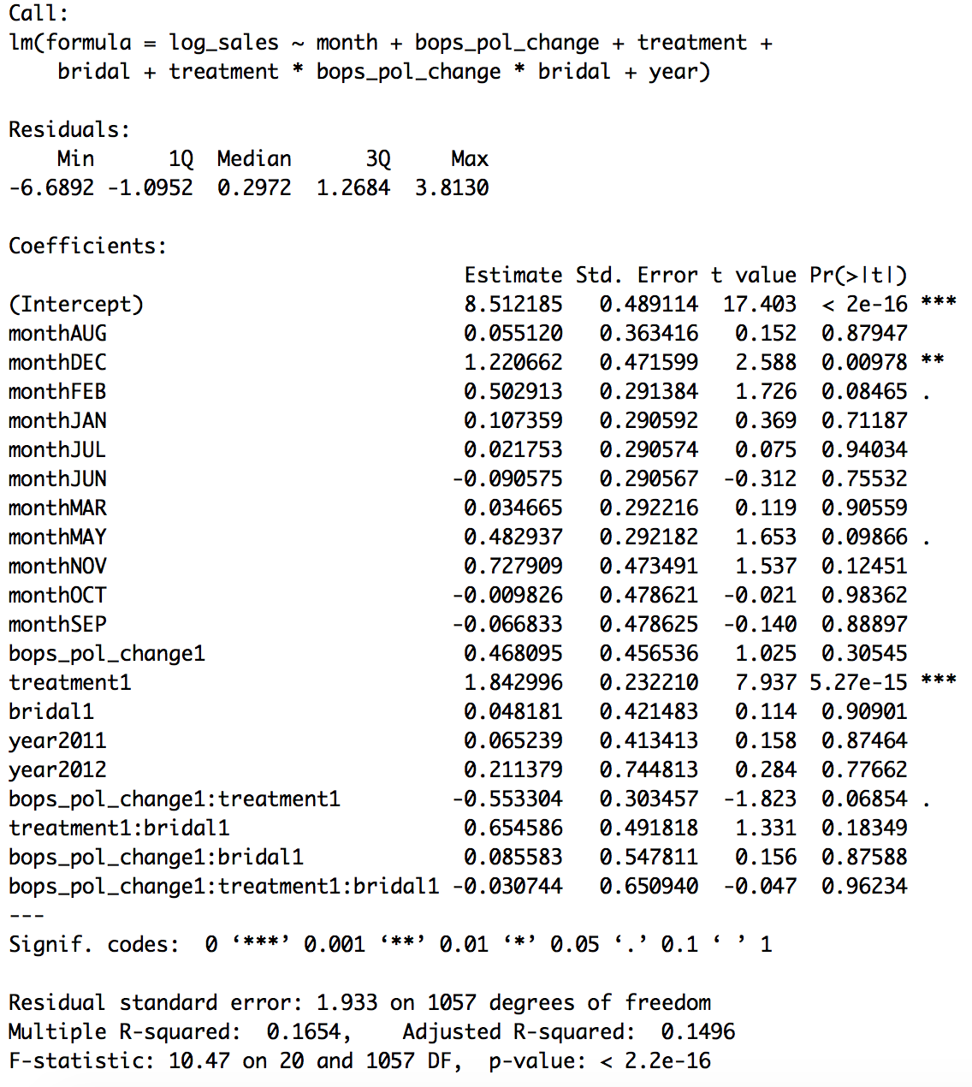
Sales: Final Model
Insignificant triple interaction
of BOPS*treatment*Bridal

Slide 11
Sales: Interpretation
Model 1: We can interpret that due to the implementation of BOPS there is decline in Online sales which contradicts our initial assumption.
BOPS reduces the online sales. BOPS requires a reliable inventory sharing system, so customers tend to research online and then buy in nearby stores. BOPS reduces the online purchase and increase in-store purchase and traffic.
Model 2: From this model we can interpret that BOPS has no impact on bridal which inlines with our assumption.
Gallino, S., & Moreno, A. (n.d.). Integration of Online and Offline Channels in Retail: The Impact of Sharing Reliable Inventory Availability Information. S2SRN Electronic Journal. doi:10.2139/ssrn.2149095

Slide 12
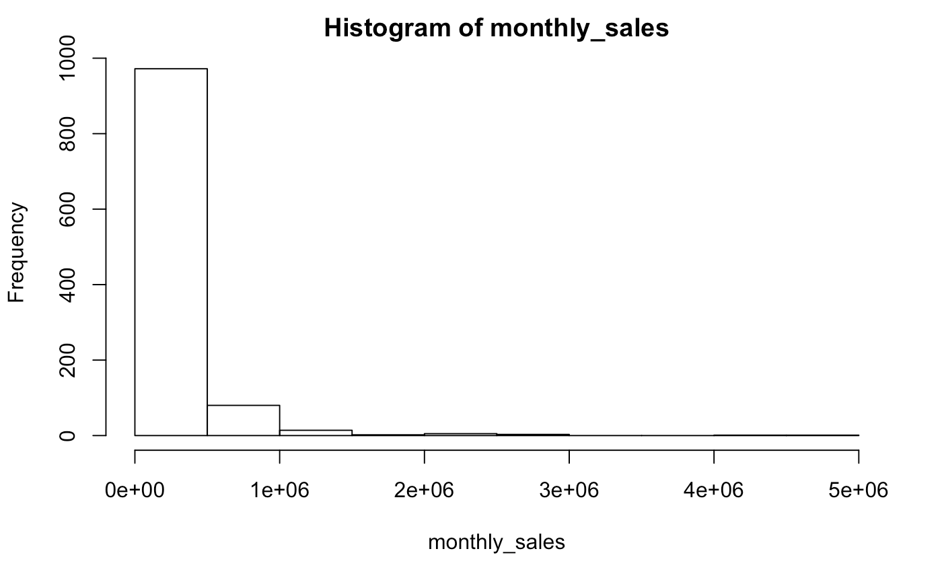
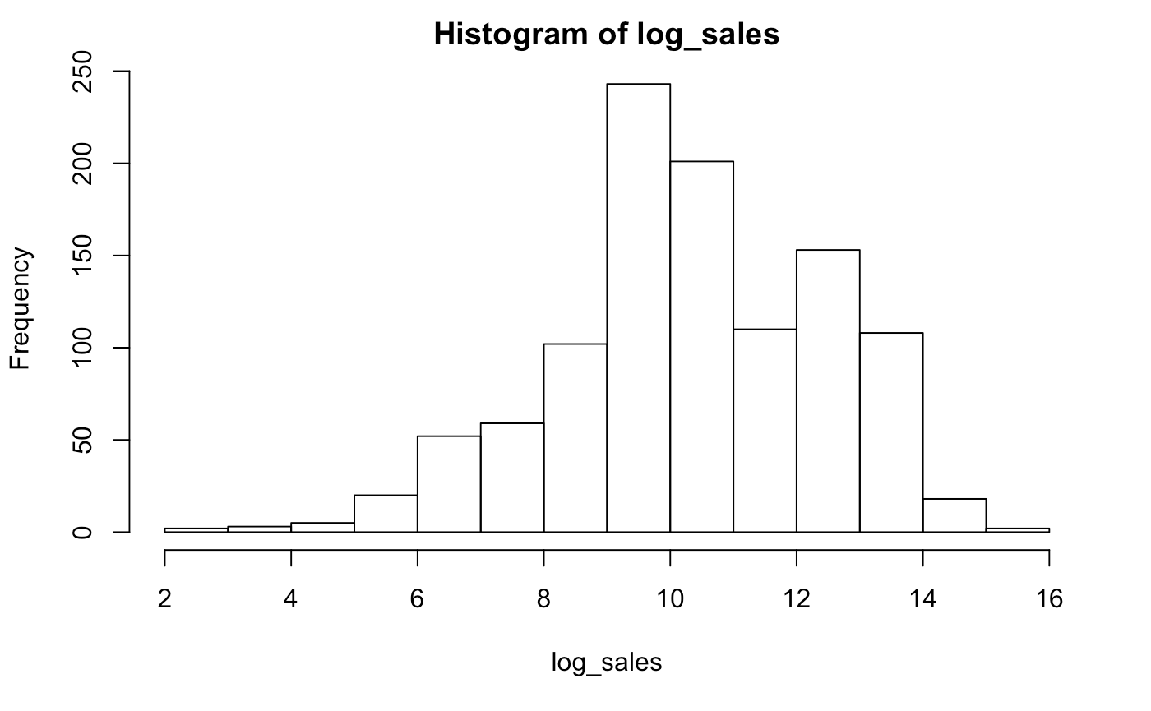
Sales: Data Visualization

Slide 13
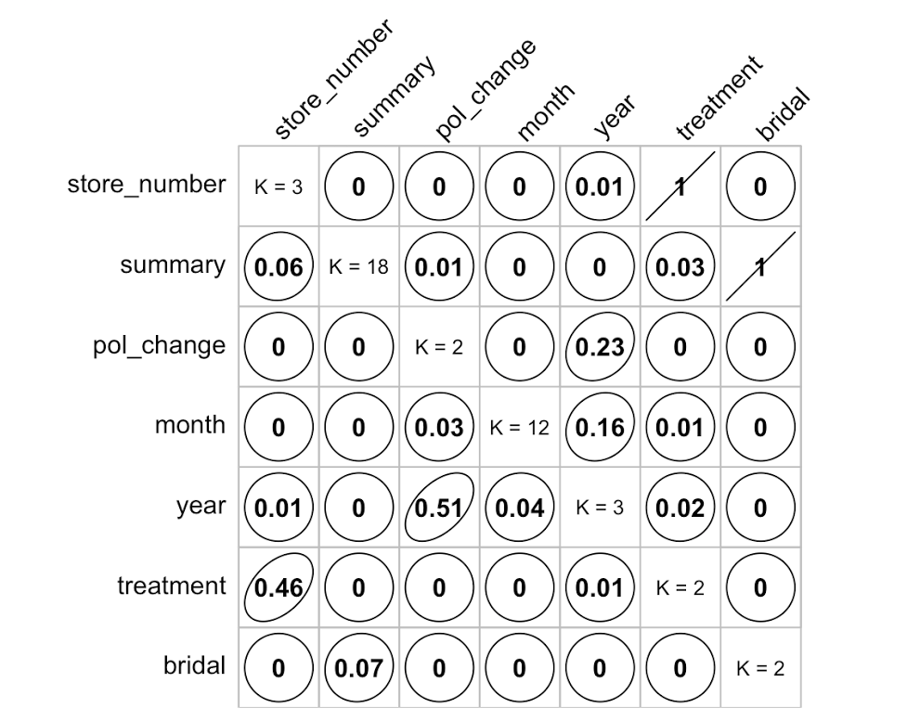
Sales: multicollinearity
Correlation of Factor Variables
library(GoodmanKruskal)
GK_correlation_matrix <- GKtauDataframe(factor_variables)
plot(GK_correlation_matrix,diagSize = 0.8,diagColor = "black", backgroundColor = "white",colorPlot=FALSE)
No multicollinearity

Slide 14
Sales: Endogeneity and IVs
There will be no endogeneity in Sales model as any change in Channel 2&6 it is even captured in Channel 5998

Slide 15
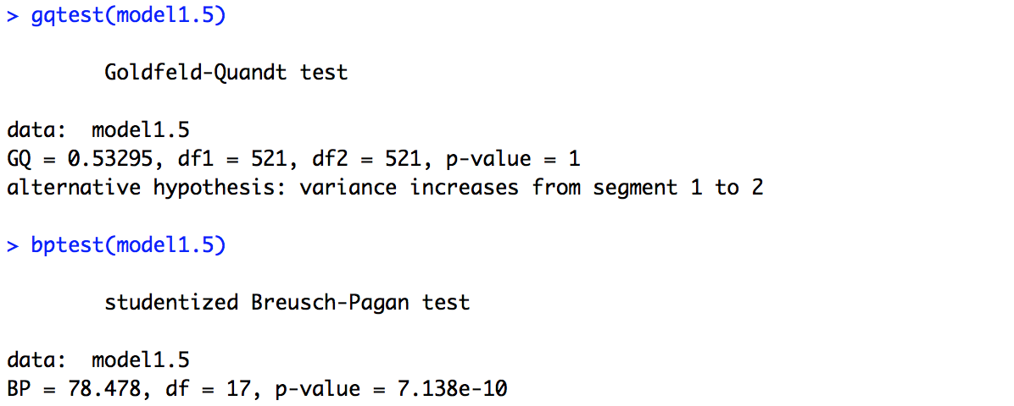
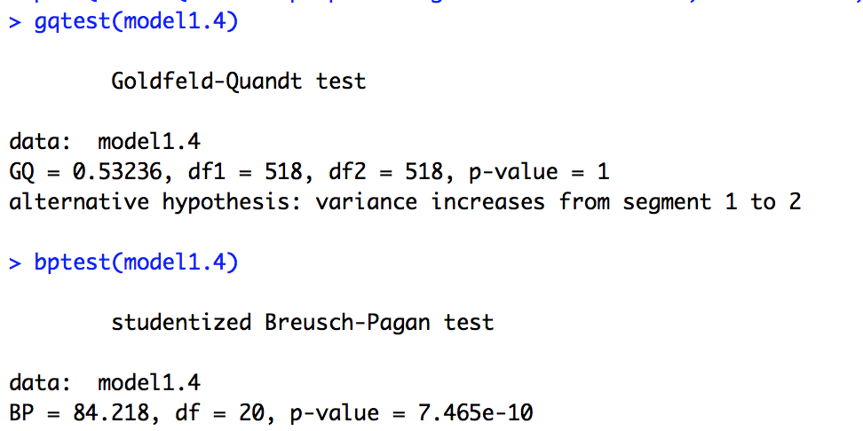
Sales: Heteroskedasticity

Slide 16
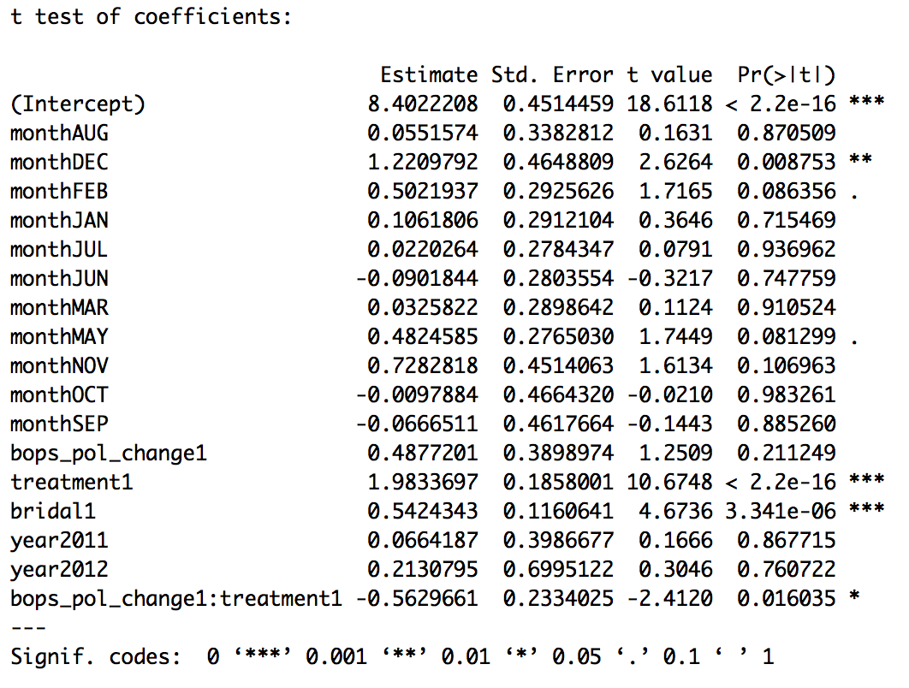
Sales: Robust Standard Errors - Two Variable Interaction

Slide 17
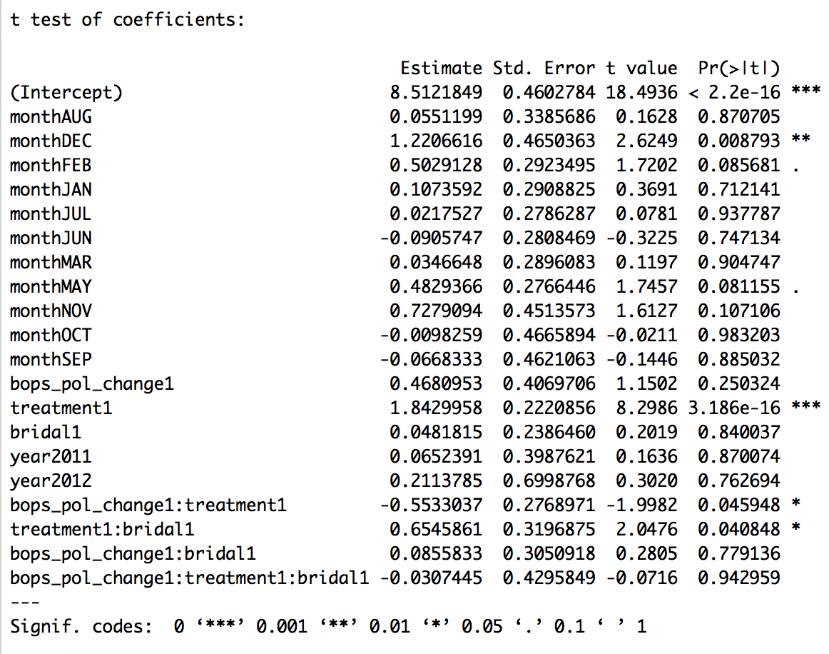
Sales: Robust Standard Errors - Three Variable Interaction

Slide 18
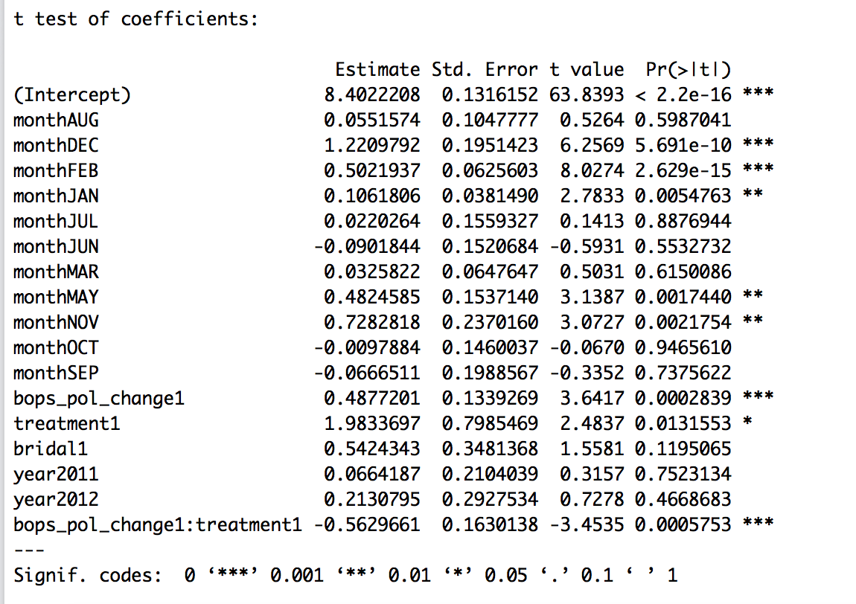
Sales: Clustered Robust Standard Errors - Two Variable Interaction
Clustered by Store

Slide 19
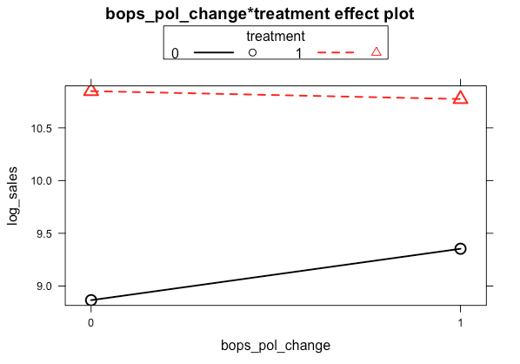
Sales: Marginal Effect Plots

Slide 20
Return Model
 | Dependent Variable | Variable Type
1 | Return | Binary
Goal:
To evaluate the impact of BOPS policy on return
 | Independent Variable | Variable Type
1 | BOPS | Binary
2 | Log Net Purchase Amount | Continuous
3 | Income | Continuous
4 | Gender | Binary
5 | Age | Continuous
6 | Store Number | Factor
7 | Month | Continuous
8 | Summary (Categories) | Factor
Key
Variable

Slide 21
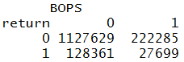
Return: Logit Ratio
Return | Count | Number of Independent Variables | Ratio
1 (Yes) | 156,060 | 8 | 156,060 / 8 = 19,508
0 (No) | 1,349,914 | 8 | 1,349,914 / 8 = 168,739
Satisfy the minimum 10:1 ratio requirement
Notes:
In the lower matrix, we want to make sure there’s no 0 cells.

Slide 22
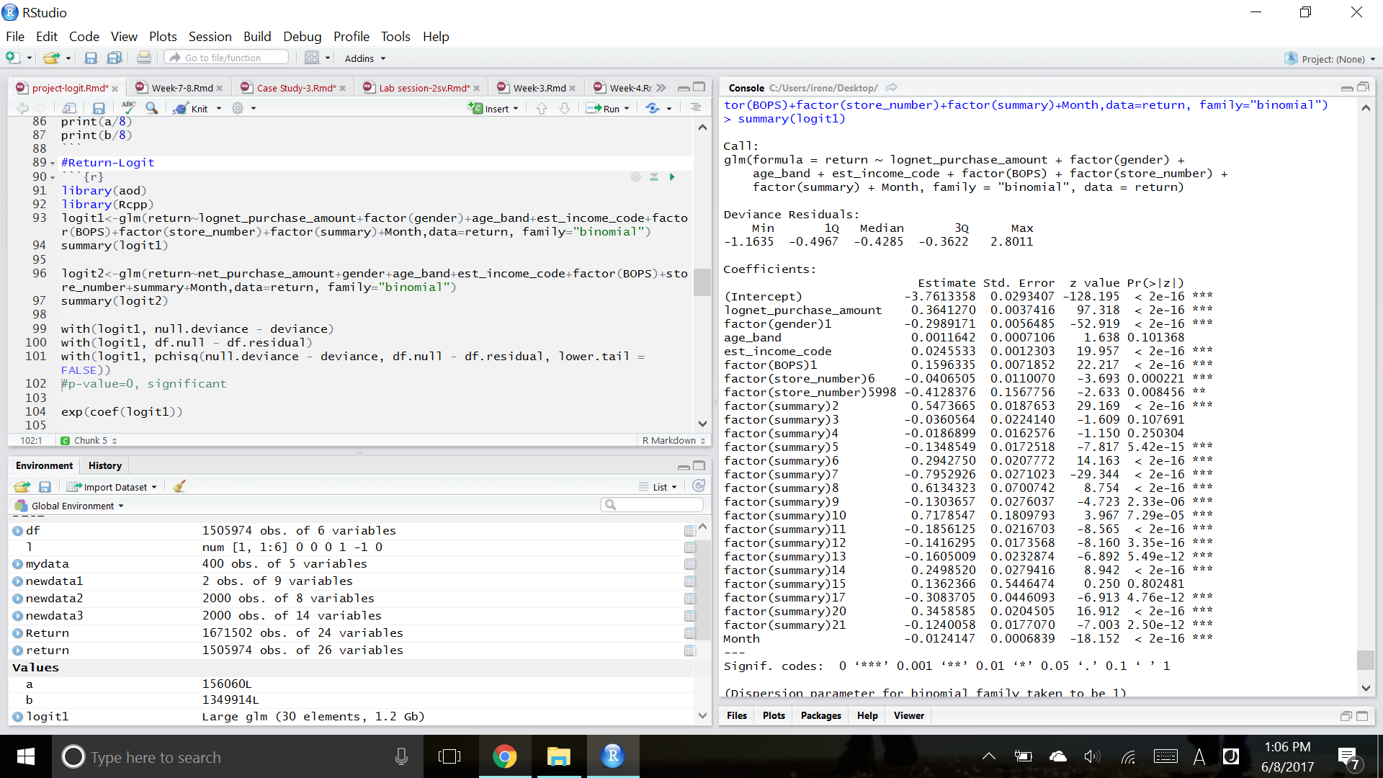
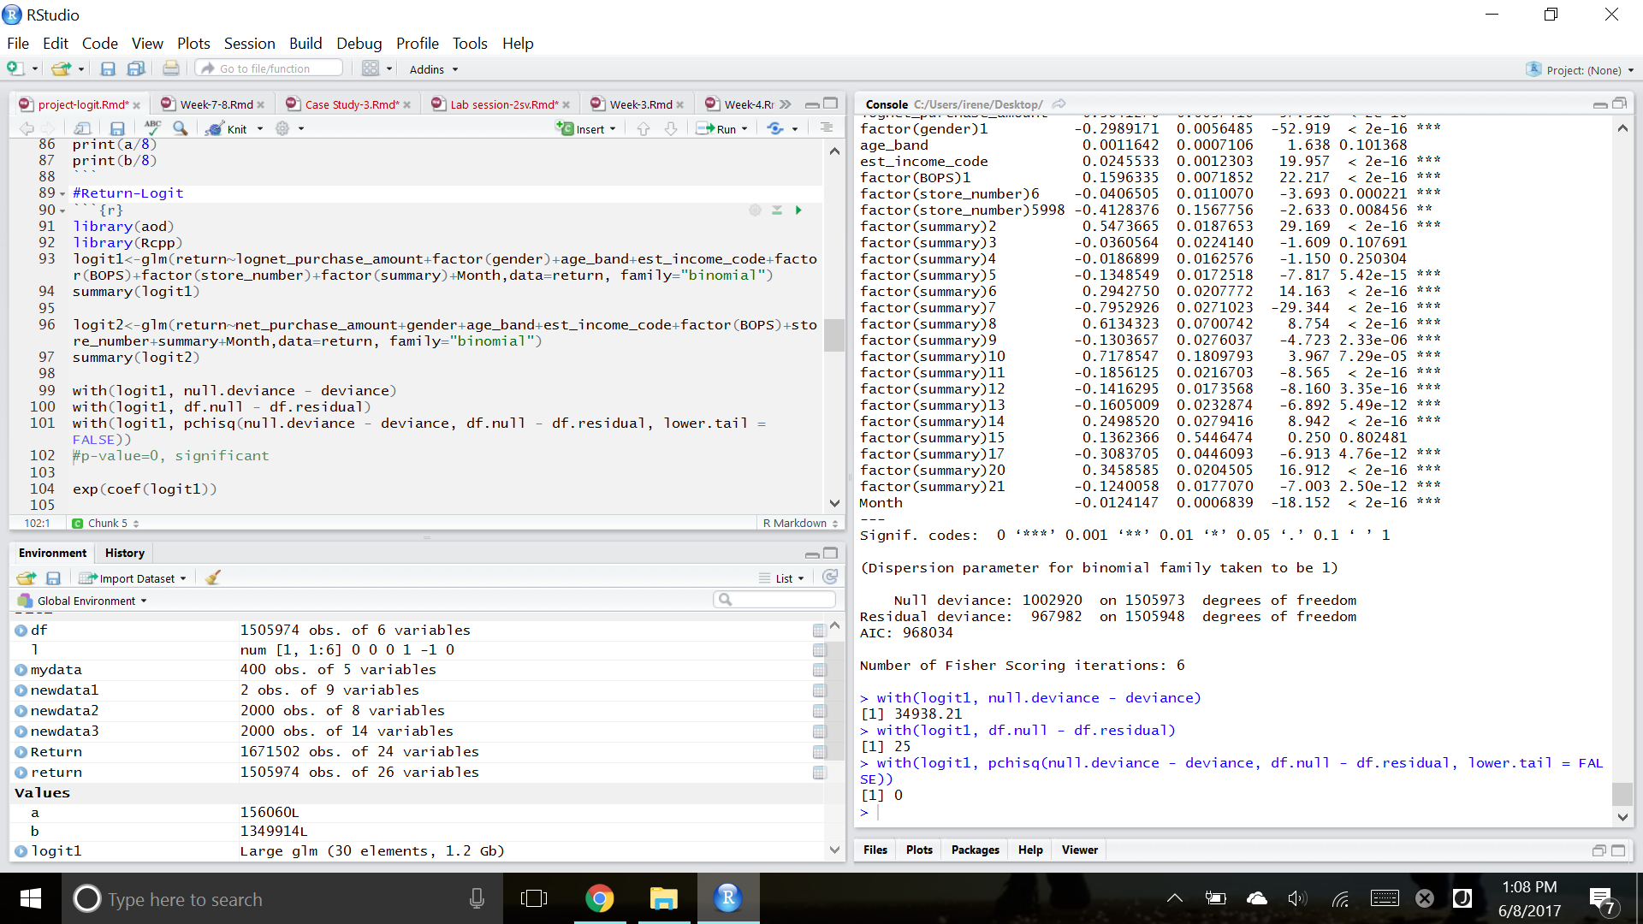
Return: Final Logit Model
Notes:
For every one unit change in independent variable, the log odds of return (vs. no return) increases by 0.16

Slide 23
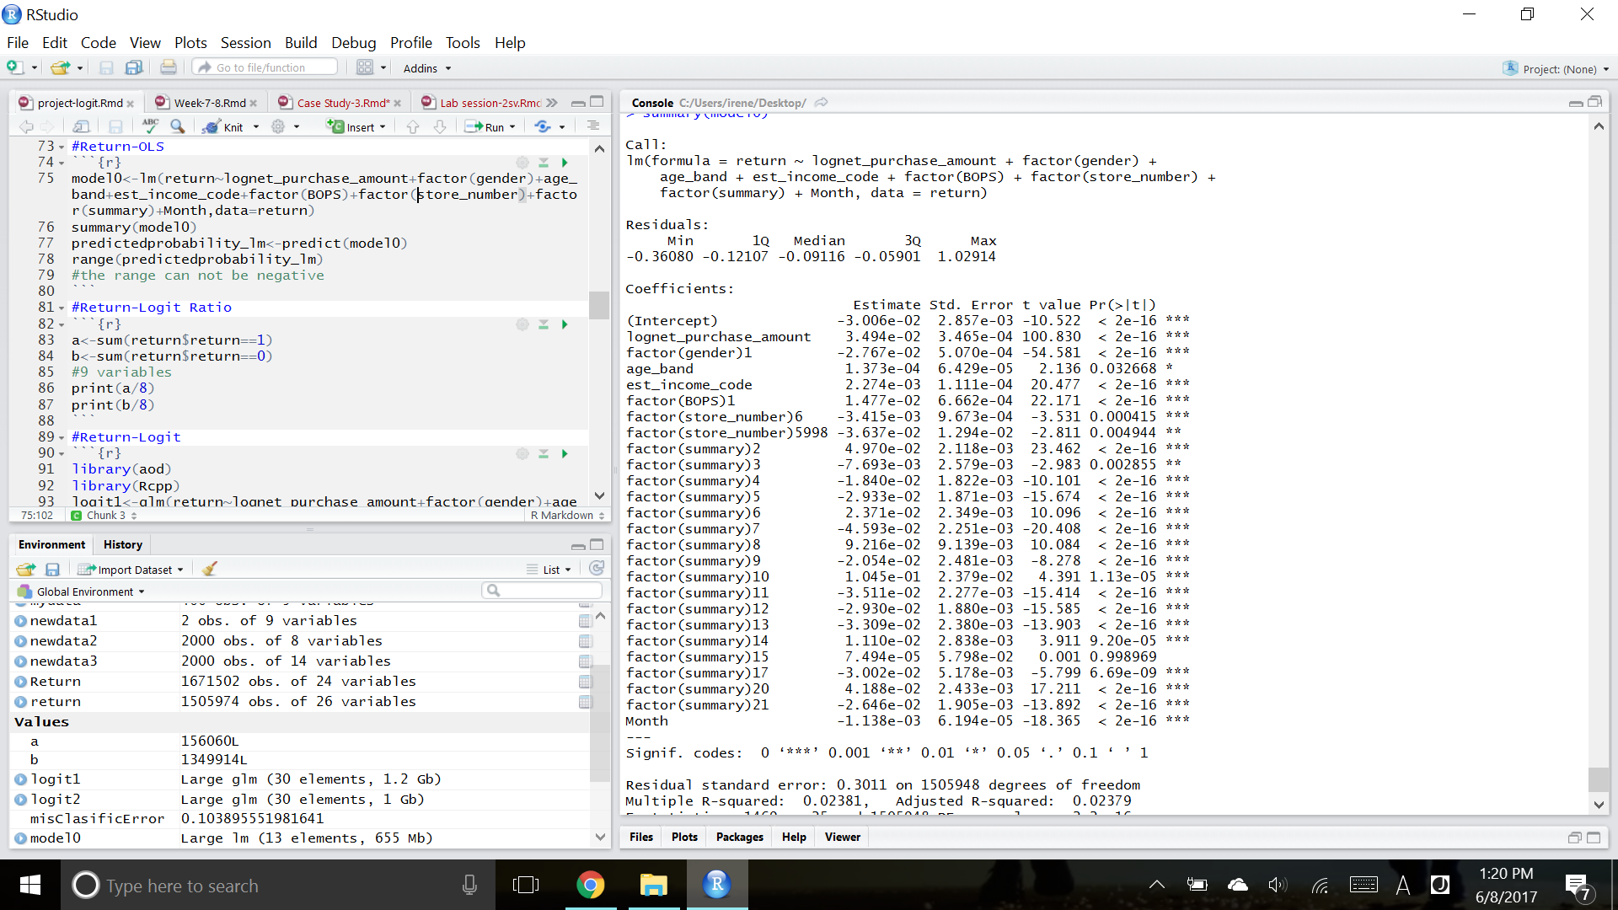
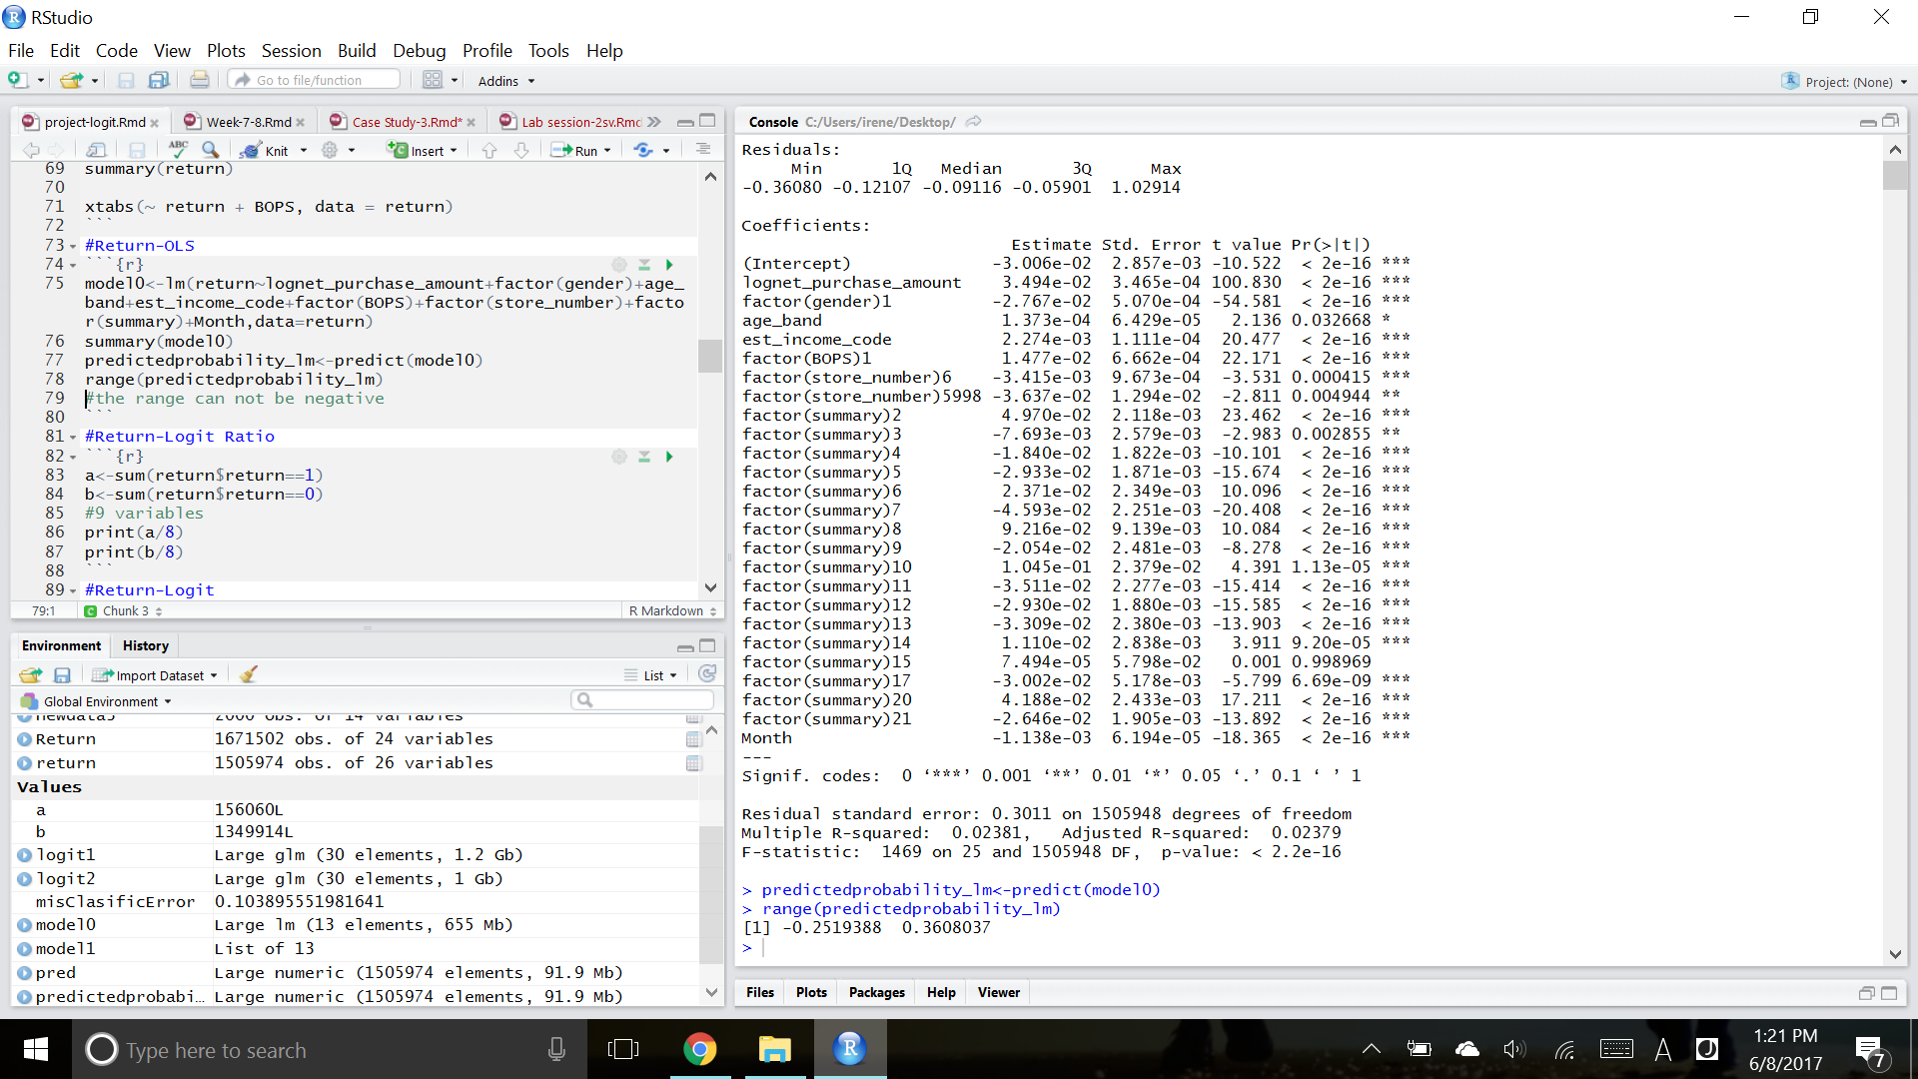
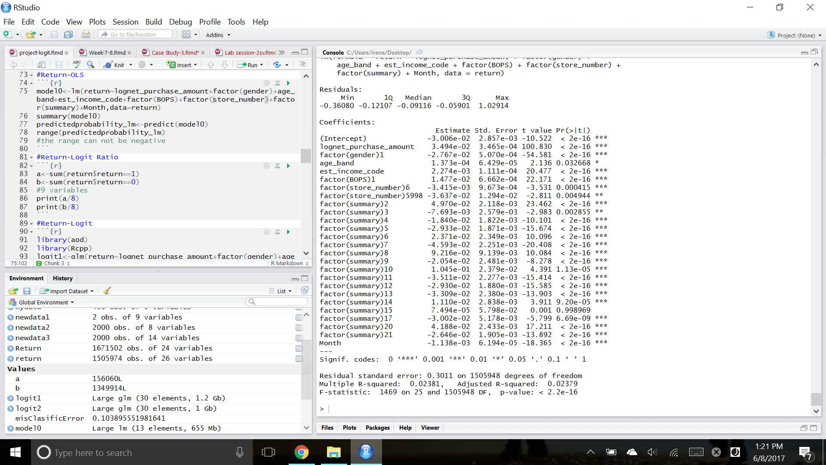
Return: OLS Model
Notes:
Range of the predicted probability+return is binary -> show should use logit model

Slide 24
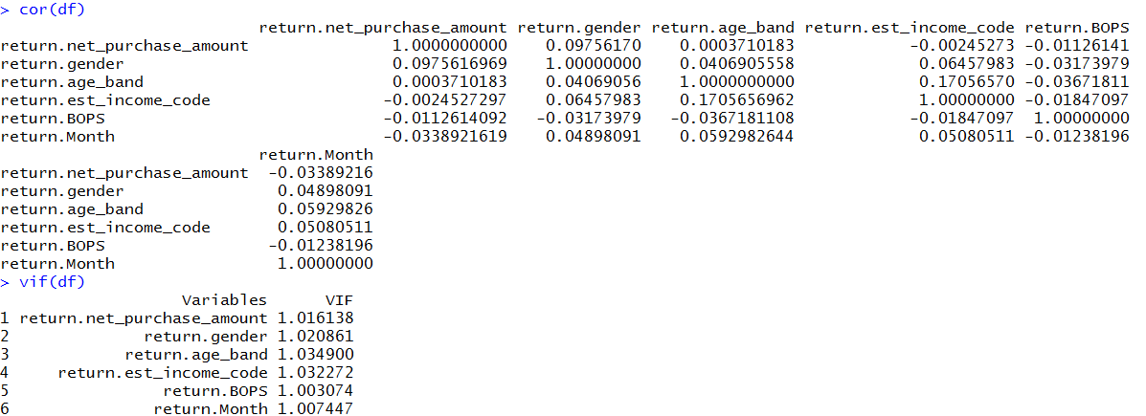
Return: Correlation and VIF
No multicollinearity in the model
Notes:
The variables here are all in the OLS model we showed

Slide 25
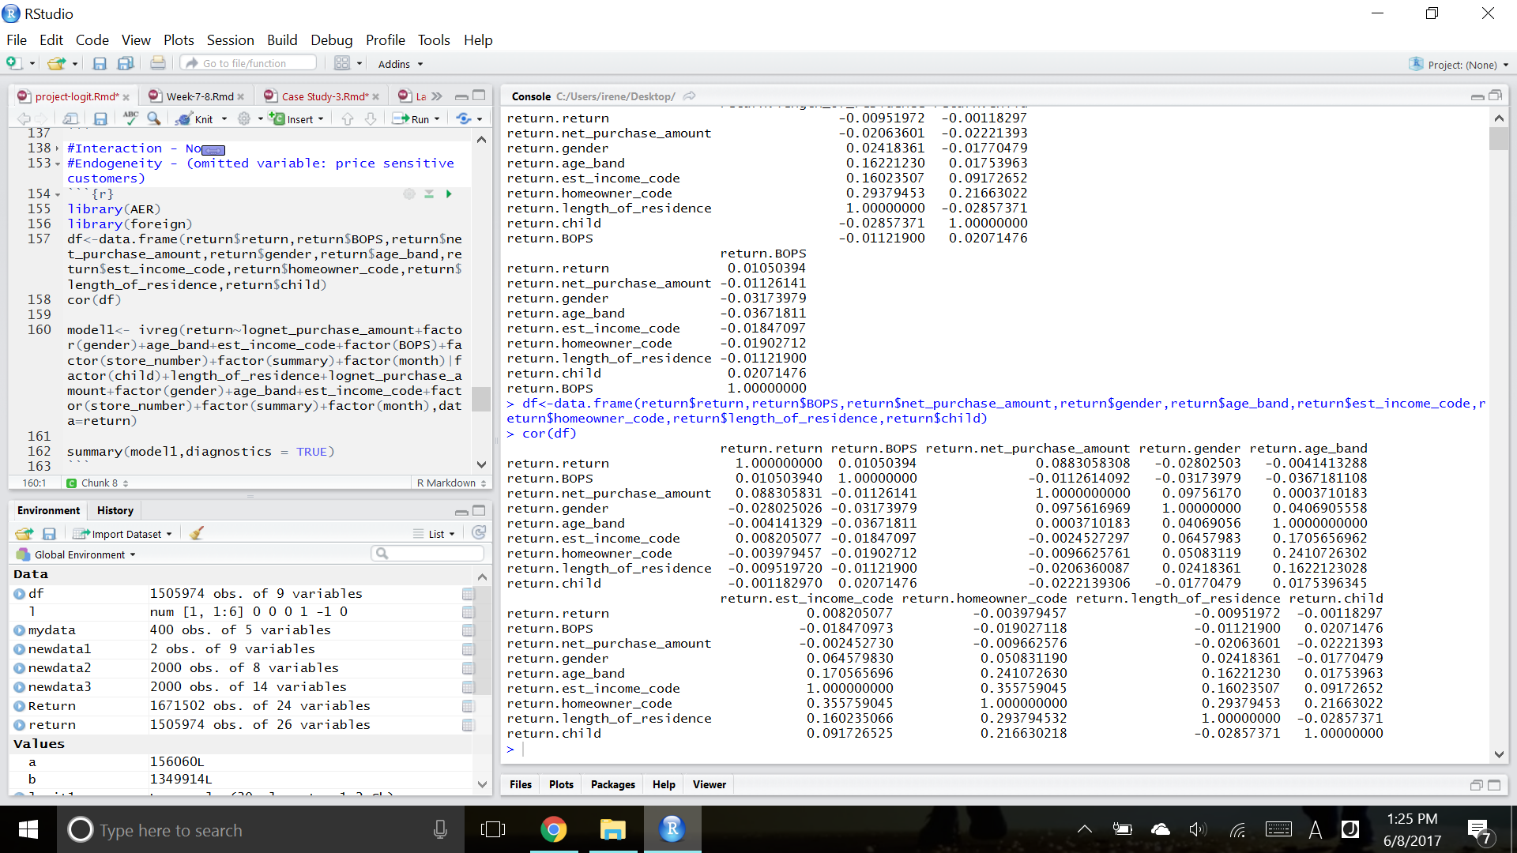
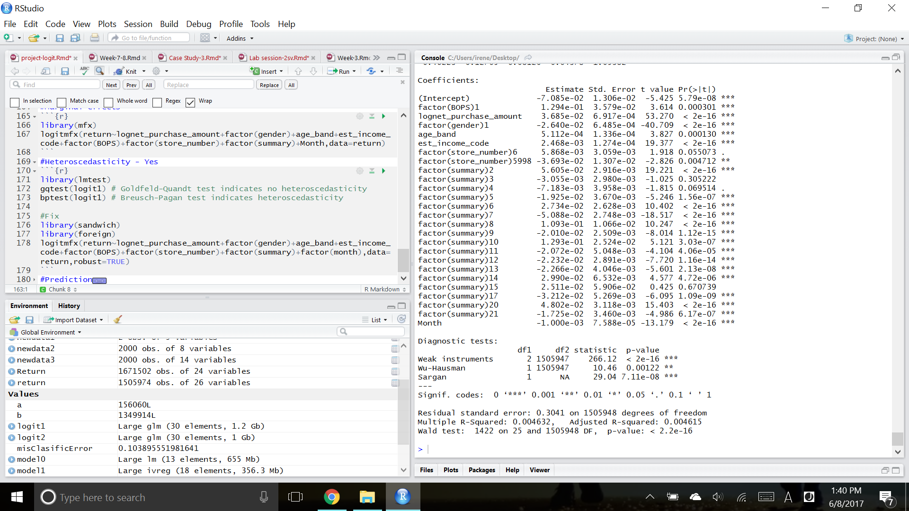
Return: Test Endogeneity using OLS model
Potential IVs: Child & Length of Residence
Relevant IVs
Failed on Sargan Test
Unable to use Hausman Test
We don’t have good IVs in the current dataset...
Notes:
Price sensitive customers as an omitted variable

Slide 26
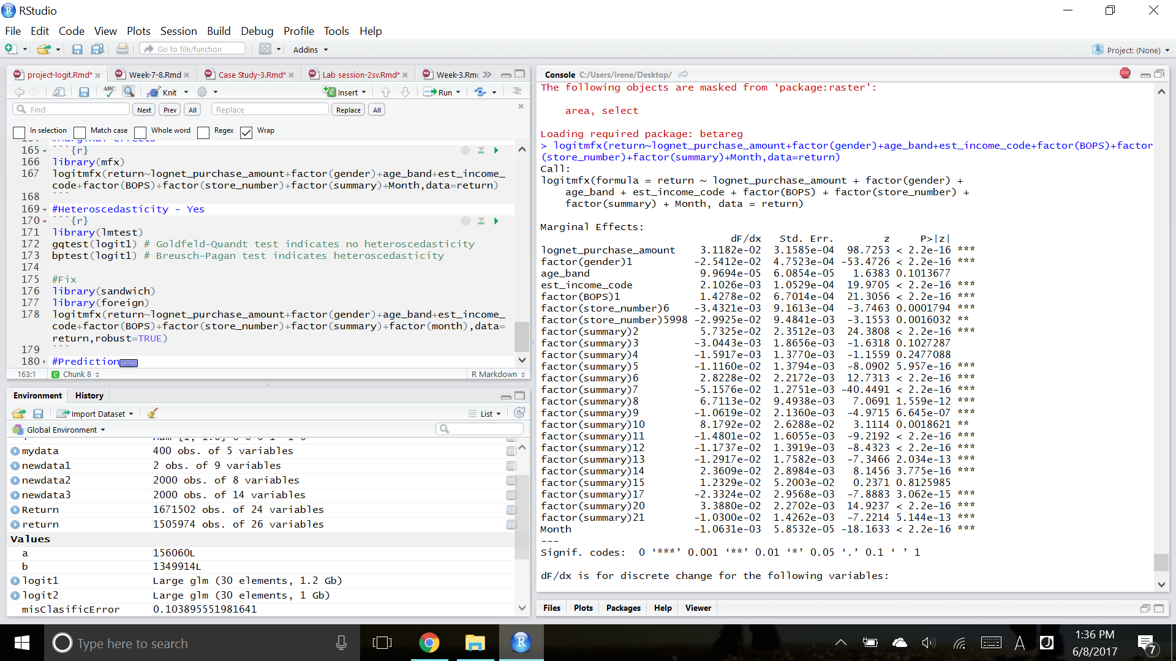
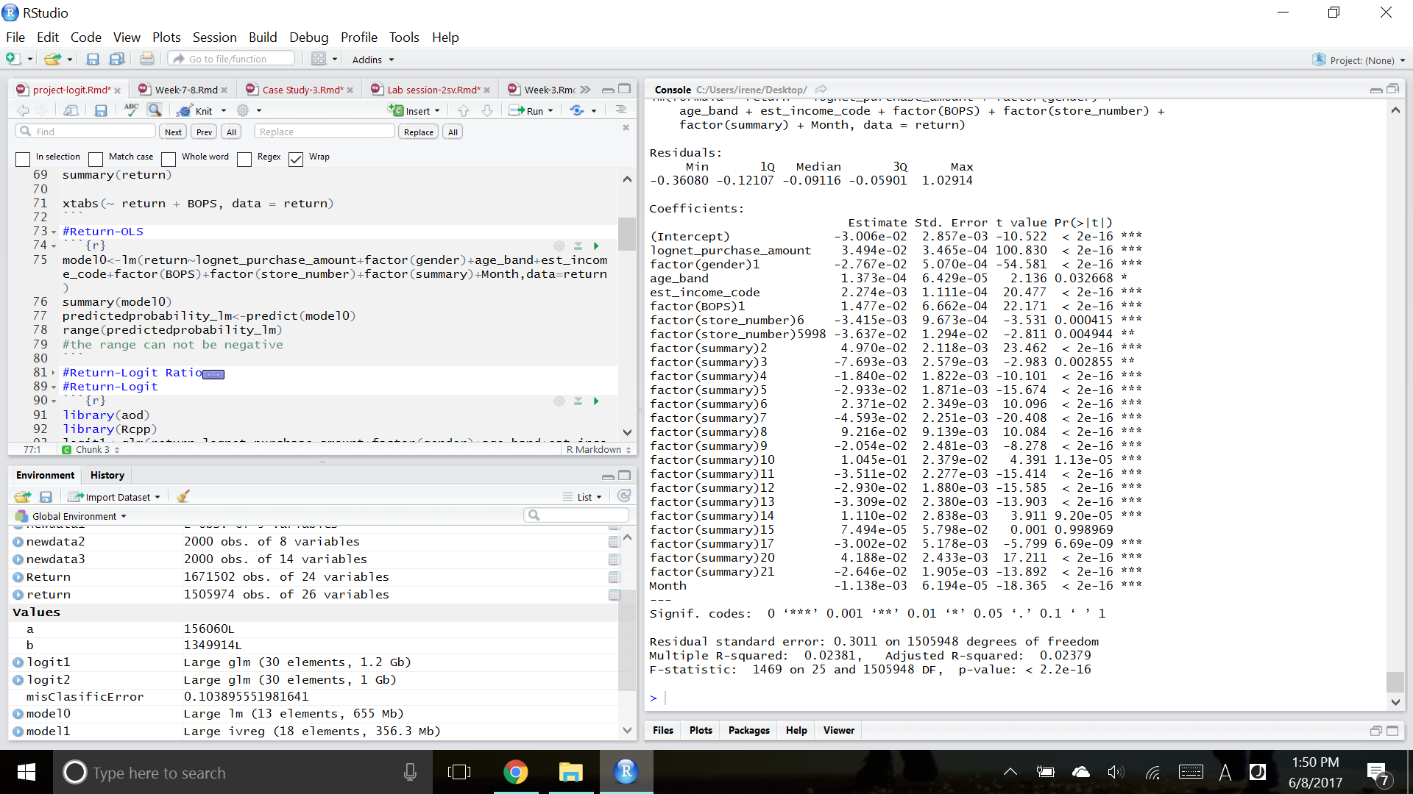
Return: Endogeneity - Logit marginal vs OLS
Marginal Effects
OLS with IVs

Slide 27
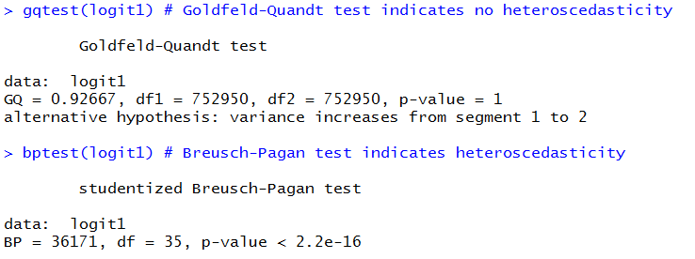
Return: Heteroscedasticity?

Slide 28
Return: Marginal Effect
&
Robust standard errors
Notes:
Robust std. error to
Still significant

Slide 29
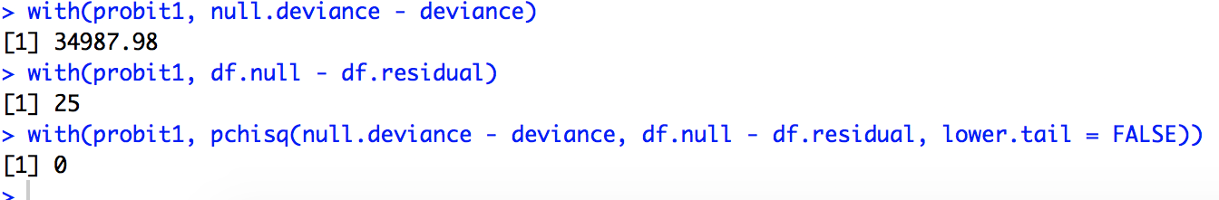
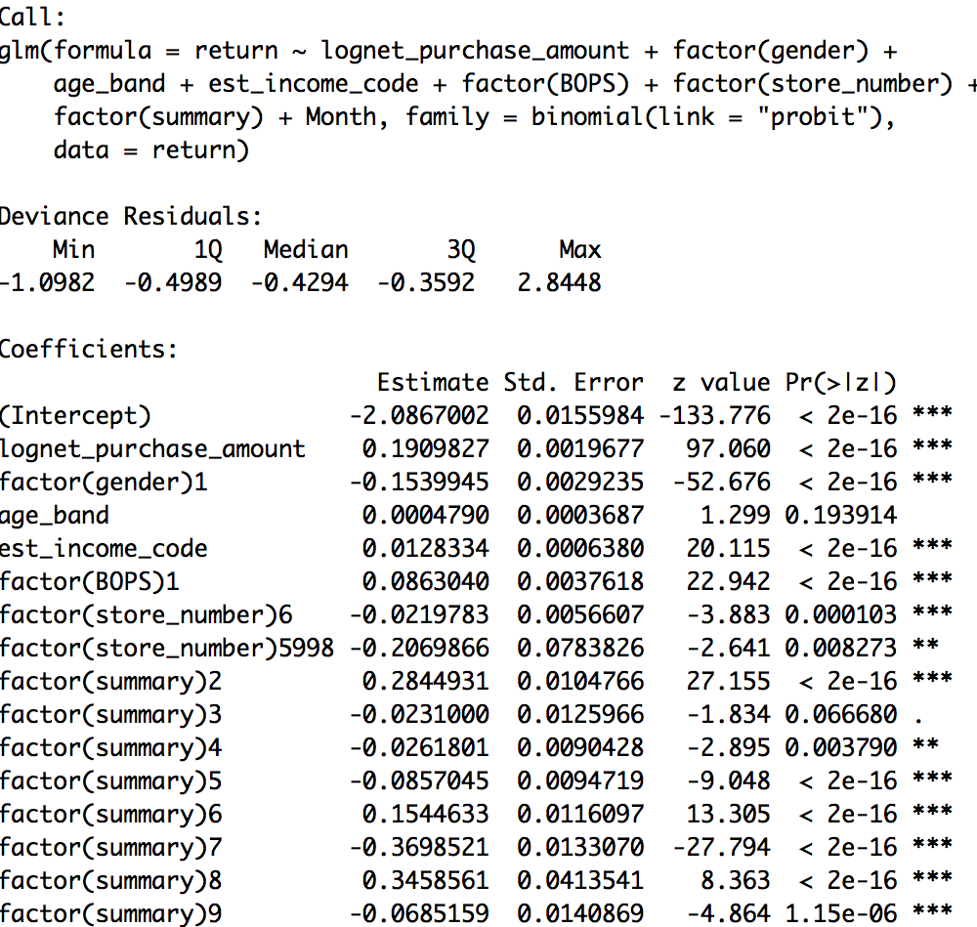
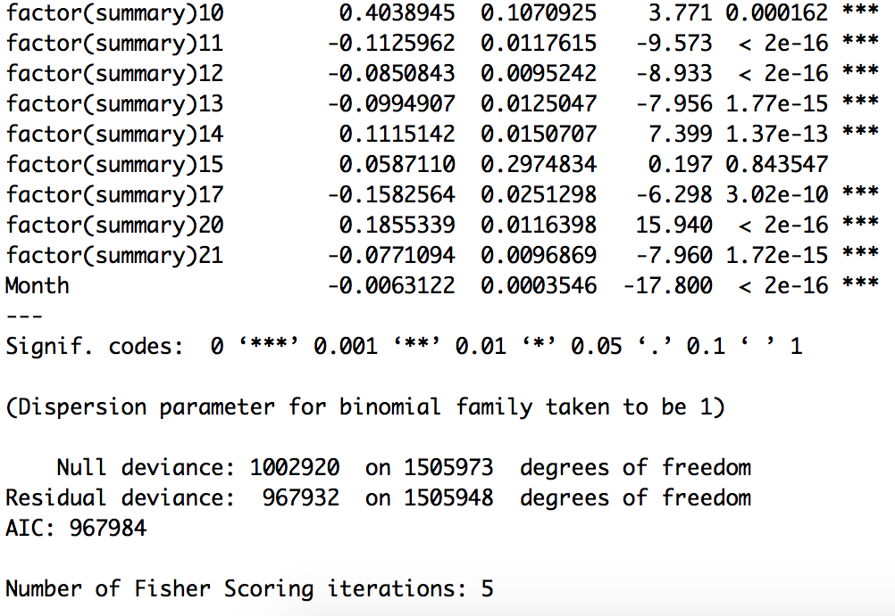
Return: Probit Model
Notes:
For every one unit change in BOPS, the z-score increases by 0.086

Slide 30
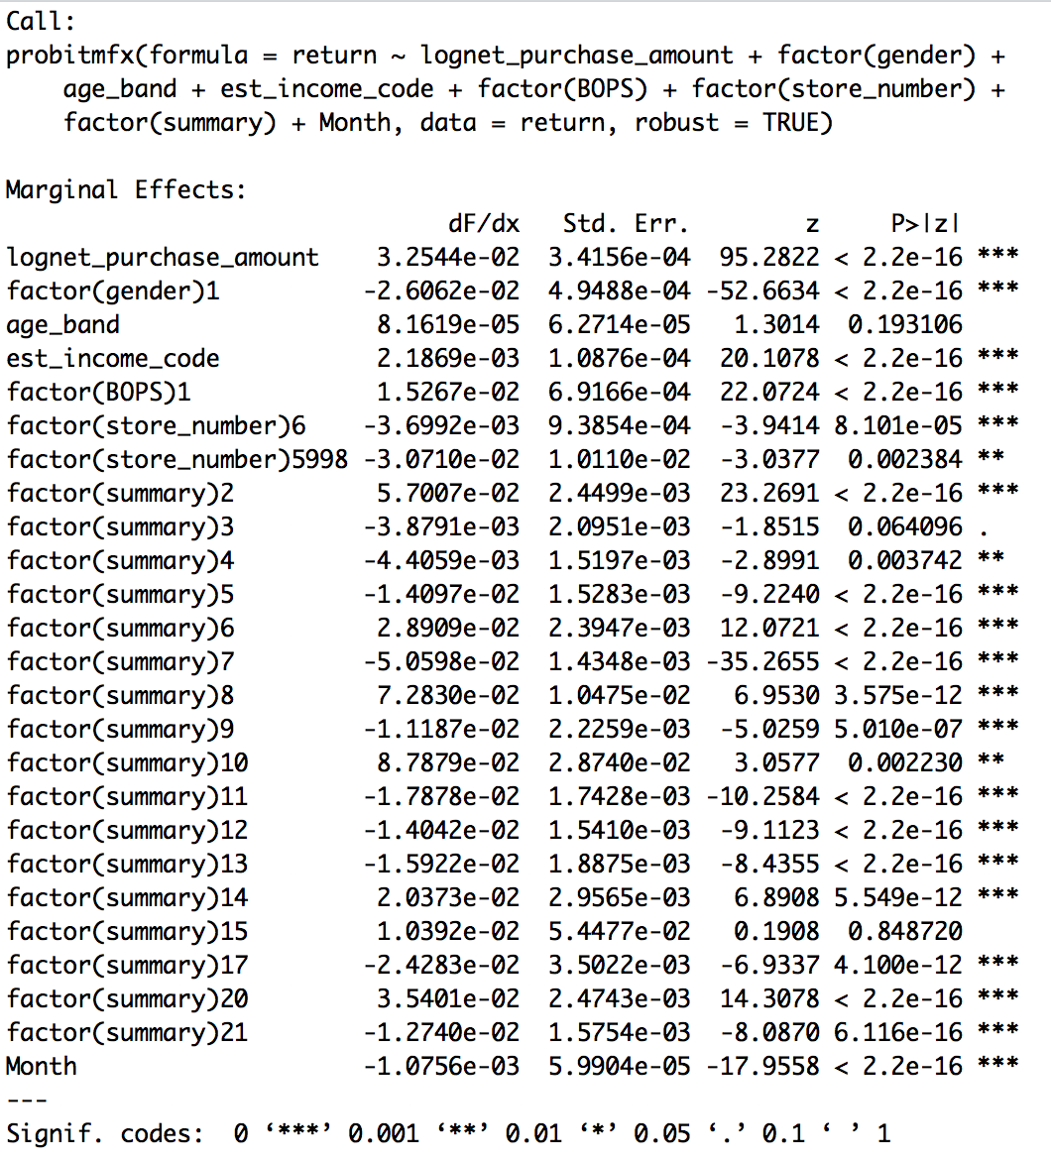
Return: Marginal Effect (Logit vs Probit)
Notes:
See if there is any difference between logit and probit model
Coefficient is quite identical to each other
Use logit model to do prediction

Slide 31
Return: Prediction
 | False | True | Total
0 | 1,349,310 | 604 | 1,349,914
1 | 155,860 | 200 | 156,060
Total | 1,505,170 | 804 | 1,505,974
Correct classification rate:
(1,349,310+200) / 1,505,974
=89.61%
Notes:
This is the confusion matrix generated from our logit model
Correct classification rate is 89.61%

Slide 32
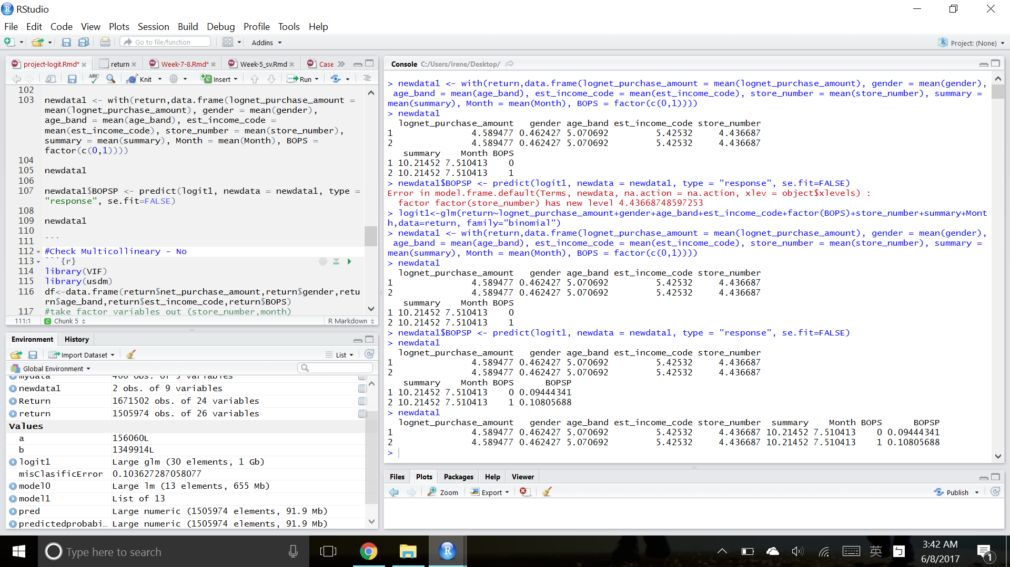
Return: Prediction
With BOPS | Without BOPS | Difference
10.80% | 9.44% | 1.36%
Notes:
To measure the effect of bops, we include all relevant control variables
e.g log purchase amount, the product category variable and gender etc
It shows the predicted probability of return with BOPS is 10.8% and without BOPS is 9.44%
Difference is 1.36%

Slide 33
Return: Interpretation
BOPS increase the return by 1.36%
Financial analysis:
1% return -> incurs $17M cost
1.36% return -> incurs $23.12M cost

Slide 34
Limitation
Only online channel data --- in-store data needed.
No method to quantify the sales $amount.
Information lost due to aggregation.
Better IVs in future data collection process. e.g website design, shopping habit

Slide 35
Recommendation
BOPS or no BOPS?

Slide 36

Reference
Prof Necati Ertekin
Gallino, S., & Moreno, A. (n.d.). Integration of Online and Offline Channels in Retail: The Impact of Sharing Reliable Inventory Availability Information. S2SRN Electronic Journal. doi:10.2139/ssrn.2149095

Slide 37

Q & A

Slide 38
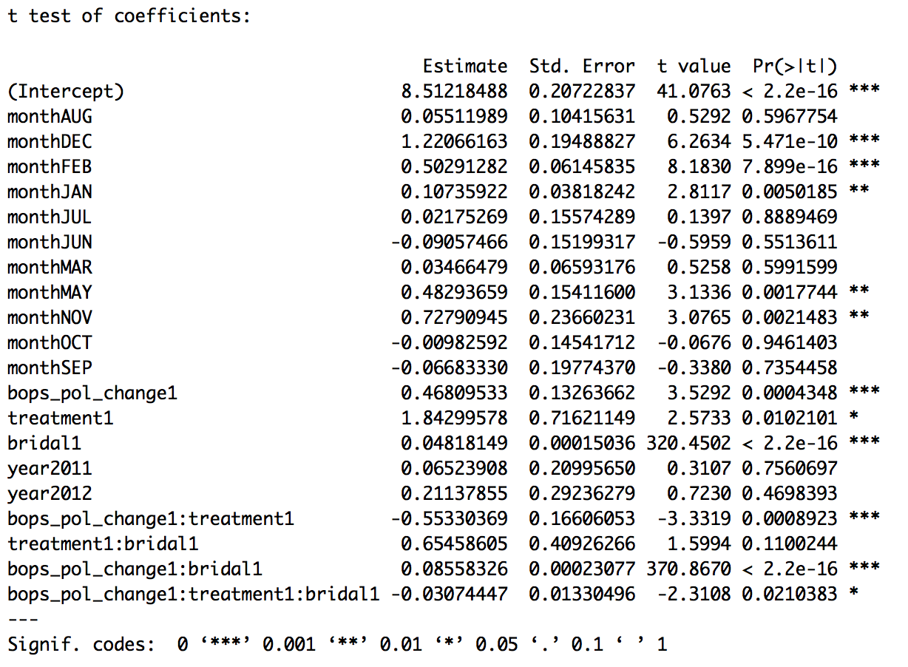
Sales: Clustered Robust Standard Errors - Three Variable Interaction
Clustered by Store

